Slide 1

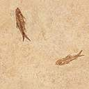

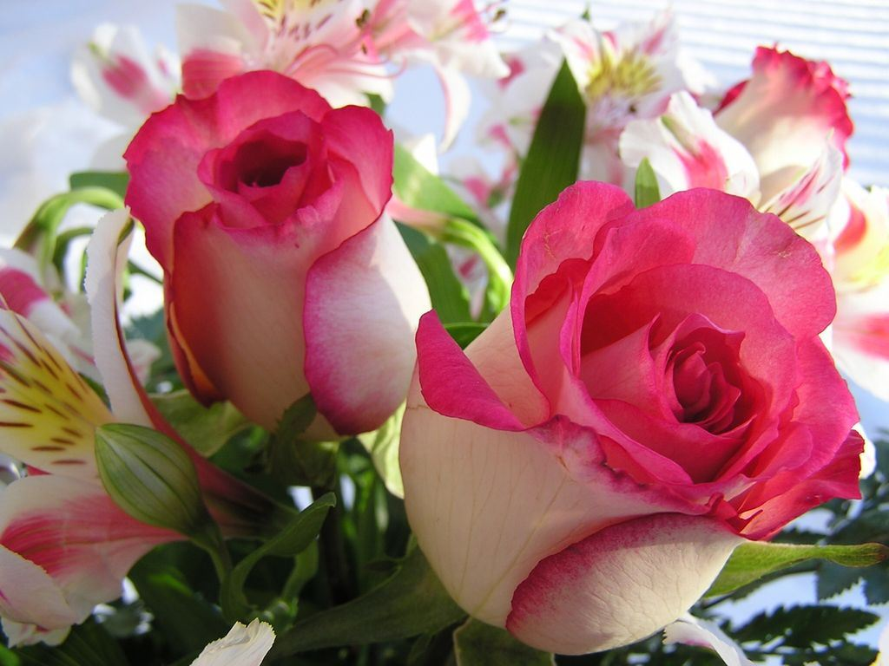
Welcome
Many many greetings to you.

Slide 2



Tanvir Ahmed Mottaki
Lecturer in English
Austugram Hossenia Alim Madrasa

Slide 3


Class:
Alim 1st year
Sub: English 1st

Slide 4
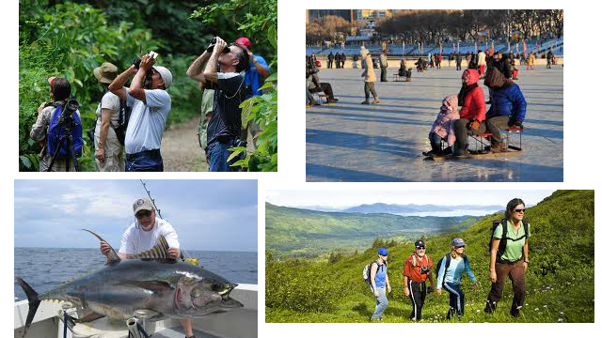

Slide 5

Pastimes

Slide 6

From this lesson students:
Will be able to understand the Pastime of
Chinese
Japanese
Canadian
Germans

Slide 7
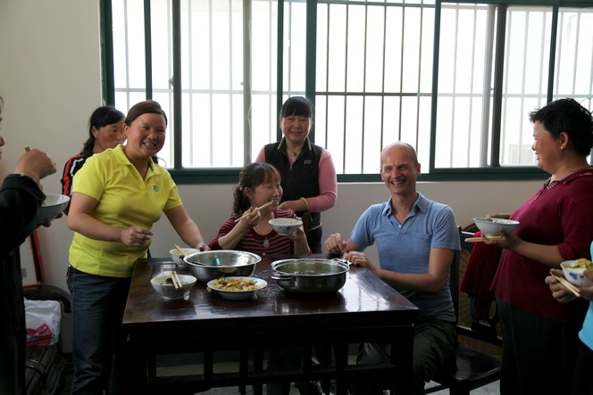
What do you understand through this picture?

Slide 8

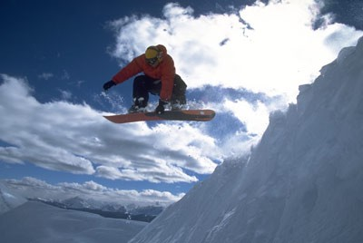
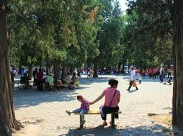
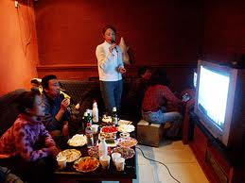
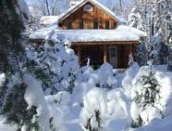
Chinese family

Slide 9
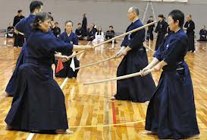
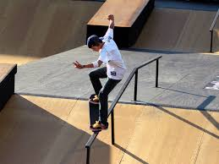

Slide 10
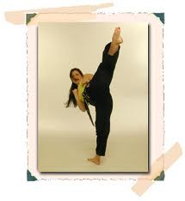
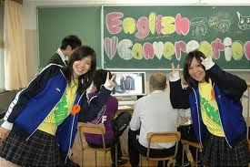
Pastimes of Japanese.

Slide 11
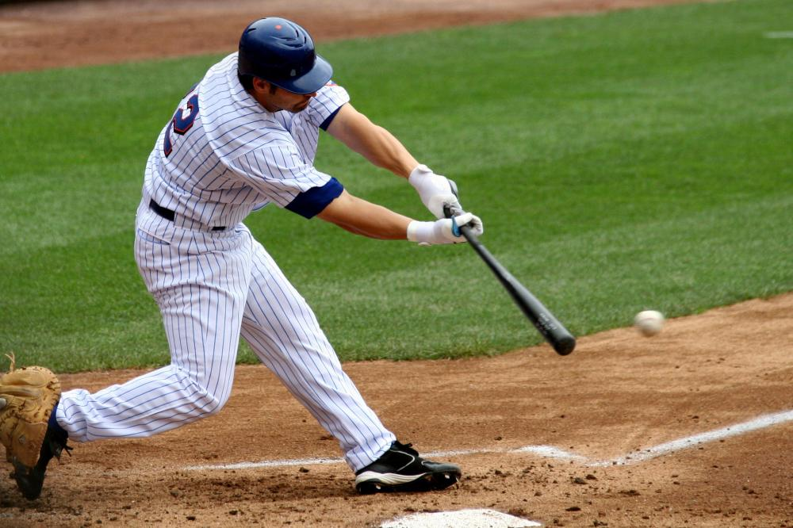
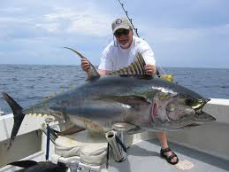



Slide 12
Pastimes of Canada

Slide 13
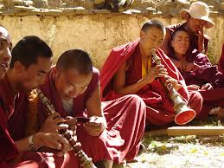
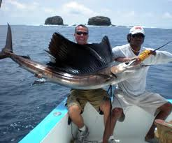
Evaluation
Find out the culture of which country
Pastime of …………………
Pastime of …………………

Slide 14
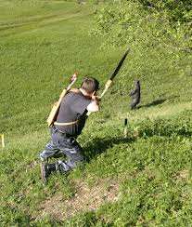
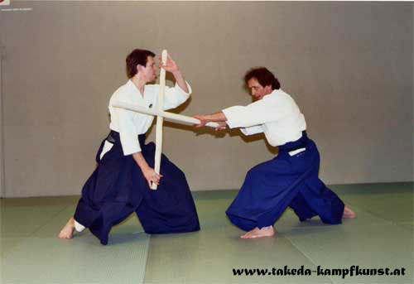
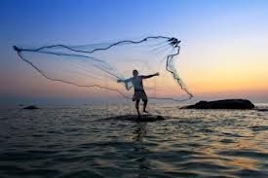
Team Work
Find out the name of country and describe these pastime

Slide 15
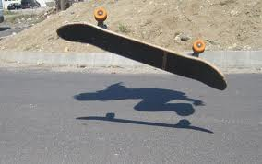
Home work
Write a paragraph according to these pictures

Slide 16

Thanks

